Slide 1



Designing Together:
Creating Environments & Experiences
for Child and Adult Survivors’ Wellbeing
Presented By:
Wendy Mota, Mie Fukuda, Lonna Davis
Notes:
Co-brand please, Nivea! THANK YOU ☺

Slide 2

Learning Agenda
Recognize the value in designing programming, policies and services that center child & parent survivors together
Describe the 5 Protective Factors in the Protective Factors for Survivors of Domestic Violence Framework
Apply the Protective Factors for Survivors of DV framework to their approach in working with child and parent survivors together
Identify opportunities for innovation in programming, policies and services, to support child and parent survivors together

Slide 3

Impacts of DV on
Adults & Children
In the past, the mainstream belief was that if you supported the parent survivor's needs, children’s needs were met by default
However, we are shifting this belief to reflect updated trauma and resilience science
Children and adults:
Are uniquely impacted by violence;
Have separate needs that need tending to;
Health and wellbeing are intrinsically linked

Slide 4
Relationships Matter
Healing is possible!
Relationships at the heart of healing and growth
  Parent child relationship
  Advocate parent relationship
  Advocate child relationship
*Important to work with BOTH children and parent survivors
*Approaching the parent-child relationship
as a “client”

Slide 5
Context Matters
Programs can create environments and experiences that:
Promote resilience and healing for children and adults
Environments and experiences influence:
Child development
Adult and child healing, growth and wellbeing

Slide 6

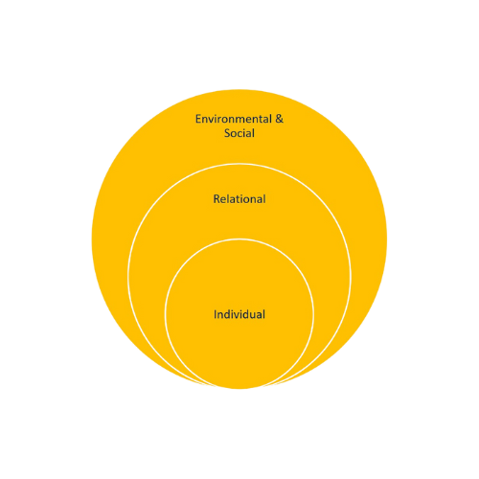
Protective Factors
What can individual &
relational attributes, and
environmental & social
conditions help
accomplish?

Slide 7
Protective Factors
Reduce the impact of DV risk factors
Establish environments that support the safety, healing, and well-being of adult and child survivors of domestic violence
Build individual strengths
Promote healthy development

Slide 8
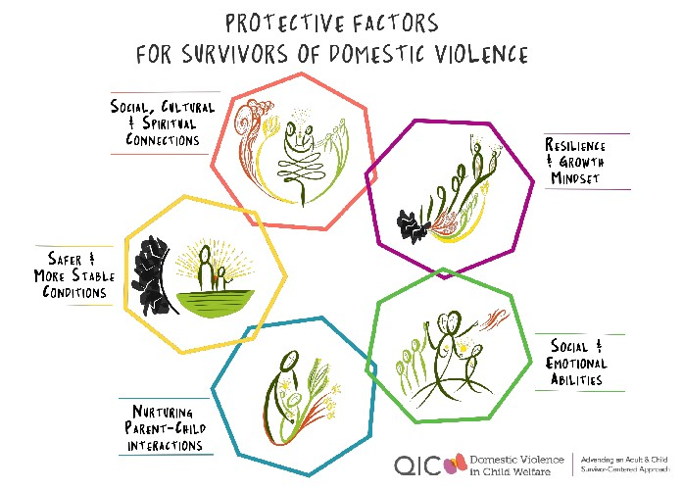
Notes:
Get a better image – for final

Slide 9
Example of How Protective Factors
are Interrelated
Social, Cultural, & Spiritual Connections
Safer & More Stable Conditions
Resilience & Growth Mindset
Nurturing Parent-Child Interactions
Social & Emotional Abilities
CWLA August 5, 2020

Slide 10
Designing Programs, Policies, and Services that Promote Protective Factors
Notes:
Consideration --- interactive ideas for participants during presentation
*Have them share what CREATIVE ways to engage children and caregivers into program design and services
What are some challenges?
Short video of youth engagement in promoting protective factors – lonna will look for this video

Slide 11
Designing Principles
Designing with communities for inclusive and engaging programming
Building and Maintaining Partnerships
Engaging Children, Caregivers and Families
Notes:
Wendy will look at advocacy matters re: program design

Slide 12
Group Think Time!
Designing with communities for inclusive and engaging programming
What are some ways you’ve built and maintained partnerships that have worked?
  What were the challenges? How did you address them?
What are some of the creative ways you’ve engaged children and families in program and service design?
  What were the challenges? How did you address them?

Slide 13
Examples:
Program Design
Using Protective Factors
Social, Emotional, & Spiritual Connections:
[Programs] set up activities, playrooms with toys, field trips for children and families as a group to build relationships together
Opportunity for healthy relationship modeling for young children
Reach out to local faith-based organizations to explore partnership ideas that promote connections outside of traditional offerings
Safe & More Stable Conditions:
Include children in shelter tours – engage them by asking questions such as, what does the building look like?
Share with them what they can expect and be sure to explain planned transitions carefully – ex. Going from meals to groups.
For staff: review policies and protocols that would decrease a sense of safety and stability for families
Notes:
Engage audience for other ideas!

Slide 14
Examples Continued:
Program Design
Using Protective Factors
Social Emotional Abilities:
Promote parent and child agency - Parents know their children best – do your programs and services truly allow for them to be the experts in their and their child(ren)’s lives?
Resources to promote mindfulness for children and parents – games parents and children can play to breathe (Belly breathes – sesame street)
Other Sesame street resources (https://sesamestreetincommunities.org/topics/traumatic-experiences/)
Resilience and growth mindset:
Support problem solving strategies for children and parents
Ex. cooking activities for parents and children (problem solving, making mistakes together and creating together)- Caminar Latino, GA
Notes:
Engage audience for other ideas!

Slide 15
Examples Continued:
Program Design
Using Protective Factors
Lullaby Project- Vermont Coalition Against Domestic Violence
  https://www.carnegiehall.org/Education/Programs/Lullaby-Project
Create a space/ playroom with toys and activities that parents and children can play in together
Nurturing parent-child interactions:
Virtual or in-person activities for children and parents to play and interact
Community activity calendar
Notes:
Engage audience for other ideas!

Slide 16
Protective Factors Creative Matrix

Slide 17
Small Group Discussion
In your small group, take fifteen minutes to answer the following questions (assign note-taker for report back):
Do you have ideas for how you could strengthen partnerships and creative engagement with children and caregivers?
What would these examples look like in your work setting/program?
Would you change or modify anything from these examples, so it’s better suited for your program? If so, please explain.

Slide 18
Small Group Discussion

Slide 19
Report Back & Conclusion

Slide 20
Thank you!
Contact Information:
Wendy Mota –
wmota@caminarlatino.org
Mie Fukuda – mfukuda@futureswithoutviolence.org
Lonna Davis – ldavis@futureswithoutviolence.org

Slide 21

VISIT OUR WEBSITE
promising.futureswithoutviolence.org
CONTACT US
info@futureswithoutviolence.org
Notes:
Nivea – please co-brand ☺

